Slide 1

API Testing
Vasilii Aleksandrov
11.2022

Slide 2
AGENDA
What is API testing?
REST vs SOAP
API testing types
Common testing strategy
What exactly needs to be verified in API testing
requests library

Slide 3

What is API testing?
API testing is a type of software testing that analyzes an application program interface (API) directly to verify it fulfills its expected functionality, security, performance and reliability.

Slide 4
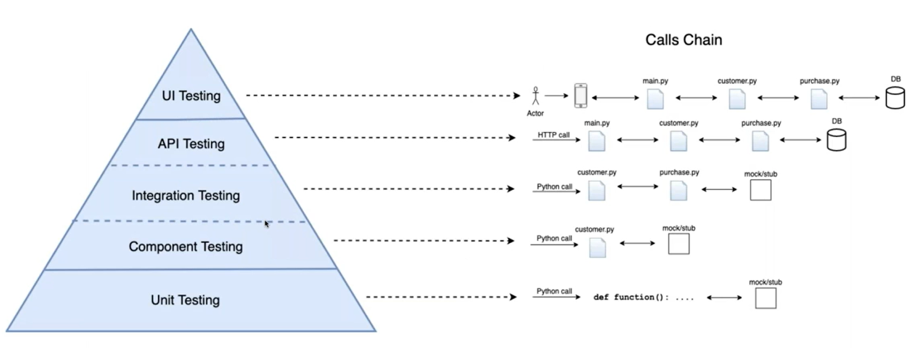
API Testing Layer Layer

Slide 5
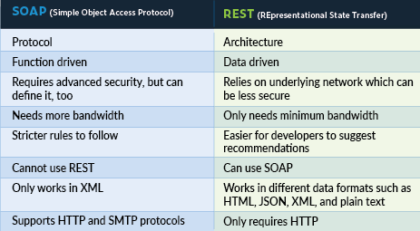
REST vs SOAP

Slide 6
API Testing Types
Functional testing
Does API have expected behavior from the business side?
Security testing
Is API vulnerable? Is data and resources protected?
Performance testing
Can API handle with required load?
Acceptance testing
Was API built correctly? Is it what customer wanted?

Slide 7
Common testing strategy
Firstly, test separate endpoints/methods of API
Positive tests
Negative tests (invalid data, invalid format, etc.)
… everything according to tests design (boundaries, classes, etc.)
Testing scenarios – testing of business logic
Stub 3rd party services – 3rd party services shall not be an object of testing
Don’t check only response on requests. Check that changes happened in the system after the call as well:
Changes in DB
Log files (errors in log files, for example)

Slide 8
What exactly needs to be verified in API testing
HTTP status codes
Error codes in case API returns any errors
Authorization checks – login/password, token, certificate, etc.
Time of response
Cached/non-cached values
The request payload is well-formed (schema validation)
The response payload is well-formed (schema validation)
The response error payloads contains the correct error message
The response matches the expected baseline. This can take 2 forms:
Regression/Diff – the response payload looks the same from call to call
Assertion – the individual elements in the response match your expectations

Slide 9

Requests library

Slide 10
Requests library
Requests is an elegant and simple HTTP library for Python, built for human beings ©
Available features:
Keep-Alive & Connection Pooling
International Domains and URLs
Sessions with Cookie Persistence
Browser-style SSL Verification
Automatic Content Decoding
Basic/Digest Authentication
Elegant Key/Value Cookies
Automatic Decompression
Unicode Response Bodies
HTTP(S) Proxy Support
Multipart File Uploads
Streaming Downloads
Connection Timeouts
Chunked Requests
Installation: pip install requests
more info: requests.readthedocs.io

Slide 11
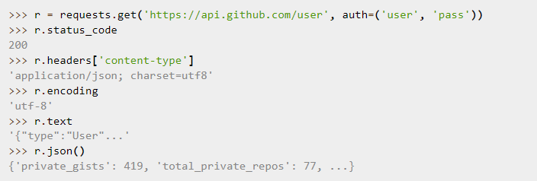
Simple usage
Example from the official site:

Slide 12
Response status codes
import requests def test_status_code(): url = "https://google.com" expected_status_code = 200 response = requests.get(url) assert response.status_code == expected_status_code, \ f"Status code from URL '{url}' is not {expected_status_code}"

Slide 13
Headers
def test_with_headers(): url = "https://somethingishere.example.com" payload_data = {"data": "Something"} headers = {"Content-Type": "application/json"} # calling with headers -> OK response = requests.post(url, data=payload_data, headers=headers) assert response.status_code == 200, \ f"Invalid status code from URL '{url}'" # calling without headers -> ERROR response = requests.post(url, data=payload_data) assert response.status_code == 200, \ f"Invalid status code from URL '{url}'"
E AssertionError: Invalid status code from URL 'https://somethingishere.example.com'
E assert 405 == 200

Slide 14
Requests with parameters
def test_with_headers(): url = "https://somethingishere.example.com" payload_data = {"data": "Something"} headers = {"Content-Type": "application/json"} # calling using json as a dict response = requests.post(url, data=payload_data, headers=headers) assert response.status_code == 200, \ f"Invalid status code from URL '{url}'" # calling using json as a str response = requests.post(url, json=json.dumps(payload_data), headers=headers) assert response.status_code == 200, \ f"Invalid status code from URL '{url}'"

Slide 15
Response content
def test_response_content(): username = "user" passwords = "password" response = requests.get(“https://api.github.com/user", auth=(username, password)) # response.json() -> dict
# response.text -> str assert response.json()[“login"] == username, “Incorrect response"
assert username in response.text, “Incorrect response"

Slide 16
Cookies
def test_cookies():
# getting cookies from response
response = requests.get("https://api.github.com/user")
print(response.cookies["cookie_name"])
# ‘{"cookies":{"from-my": "browser"}}’
# calling without cookies response = requests.get("https://api.github.com/user")
print(response.text)
# ‘{"cookies": {}}’
# passing cookies with requests
cookies_dict = {"from": "my-browser"}
response = requests.get("https://api.github.com/user", cookies = cookies_dict)
print(response.text)
# ‘{"cookies": {"from": "my-browser"}}’

Slide 17
Session
def test_without_session(): username = "user" password = "password" headers = {"Content-Type": "application/json"} # calling without Session requests.get("https://api.mysite.com/user", auth=(username, password), headers=headers) requests.get("https://api.mysite.com/data", auth=(username, password), headers=headers) # using Session session = requests.Session() # setting default values for the Session object session.auth = (username, password) session.headers = headers session.get("https://api.mysite.com/user") session.get("https://api.mysite.com/data")

Slide 18

Useful links
https://requests.readthedocs.io/en/latest/
https://realpython.com/python-requests/
https://hevodata.com/learn/soap-vs-rest-apis/

Slide 19



Questions
Vasilii_Aleksandrov@epam.com
VAleksandrov91

